Slide 1
MAPpoly training section
Marcelo Mollinari
mmollin@ncsu.edu
SCRI Workshop – January 14, 2021
This work is licensed under CC BY 4.0

Slide 2
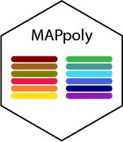
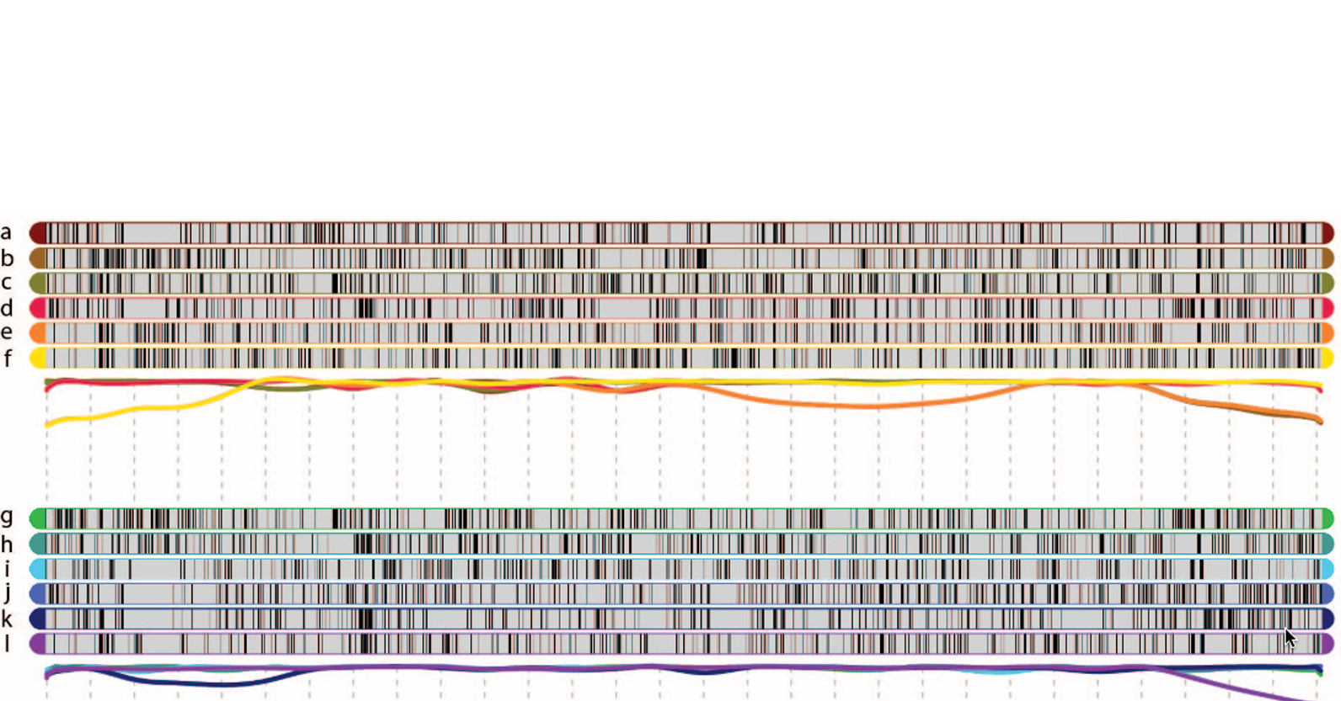
Outline
Installation
Reading/import datasets
Filtering
Two-point analysis
Grouping
Ordering
Phasing
Modeling errors/genotype probabilities
Final checking
Map summary/results
Genotype probabilities
Preferential pairing/haplotype probabilities
Hexaploid scripts/results

Slide 3





Initial notes about MAPpoly
Primary intention was implementing a program to construct genetic maps in polyploids with high ploidy levels (sugarcane, sweetpotato, etc.)
Linkage Analysis and Haplotype Phasing in Experimental Autopolyploid Populations with High Ploidy Level Using Hidden Markov Models (Mollinari and Garcia, 2019 )
Obtain conditional probabilities for QTL analysis
It does not model double reduction: double reduced markers/individuals are treated as missing data

Slide 4

Installation
From CRAN (stable version)
install.packages("mappoly")
From GitHub (development version)
install.packages("devtools")
devtools::install_github("mmollina/mappoly", dependencies=TRUE)

Slide 5


Reading/importing data sets
Supported datasets
MAPpoly files
Discrete dosage
Dosage probability
CSV files
fitPoly files
Dosage Probability
VCF files
Discrete dosage
Dosage probability
Supported R objects
updog objects
polyRAD objects
polymapR
datasets
maps
data set
mappoly.data

Slide 6
Reading/importing datasets
MAPpoly data reading functions
1. MAPpoly
dat.mappoly <- read_geno(file.in = 'path_to_input_file')
2. MAPpoly with genotype probabilities
dat.mappoly.prob <- read_geno_prob(file.in = 'path_to_input_file)
3. CSV
dat.csv <- read_geno_csv(file.in = 'path_to_input_file', ploidy = 6)
4. fitPoly, supports genotype probabilities
dat.fitpoly <- read_fitpoly(file.in = 'path_to_input_file', ploidy = 6,
parent1 = 'P1', parent1 = 'P2')
5. VCF files, supports genotype probabilities (PL field)
dat.vcf <- read_vcf(file.in = 'path_to_input_file', ploidy = 6,
parent1 = 'P1', parent1 = 'P2',
min.gt.depth = 0, min.av.depth = 0)

Slide 7
Reading/importing datasets
MAPpoly data importing functions
1. updog
dat.updog <- import_from_updog(object = input_multidog_object)
2. polyRAD
dat.polyRAD <- polyRAD::Export_MAPpoly(object = 'polyrad_object')
3. polymapR
Importing data
dat.polymapr <- import_data_from_polymapR(input.data = polymapR_screened_data,
ploidy = 6, parent1 = 'P1',
parent1 = 'P2')
Importing maps
map.polymapr <- import_phased_maplist_from_polymapR(maplist = phased_maplist,
mappoly.data = mappoly.data)

Slide 8

Reading/importing datasets
Example: reading fitPoly files
## Downloading data from GitHub
library("mappoly")
setwd("SCRI/MAPpoly/tetra")
address <- "https://github.com/mmollina/SCRI/raw/main/data/fitpoly_tetra_call/B2721_scores.zip"
download.file(url = address, destfile = "B2721_scores.zip")
unzip(tempfl, files = "B2721_scores.dat")
## Reading fitPoly data
dat <- read_fitpoly(file.in = "B2721_scores.dat",
ploidy = 4,
parent1 = "Atlantic",
parent2 = "B1829",
verbose = TRUE)
source("get_solcap_snp_pos.R")
plot(dat)
print(dat, detailed = TRUE)
Genotype calling using fitPoly:
https://github.com/mmollina/SCRI/blob/main/data/fitpoly_tetra_call/B2721_fitpoly_call.R
Adding Solanum tuberosum genome v4.03 information:
https://github.com/mmollina/SCRI/blob/main/MAPpoly/get_solcap_snp_pos.R

Slide 9
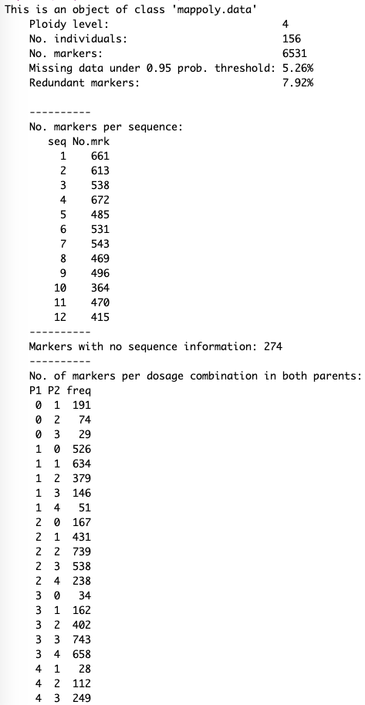
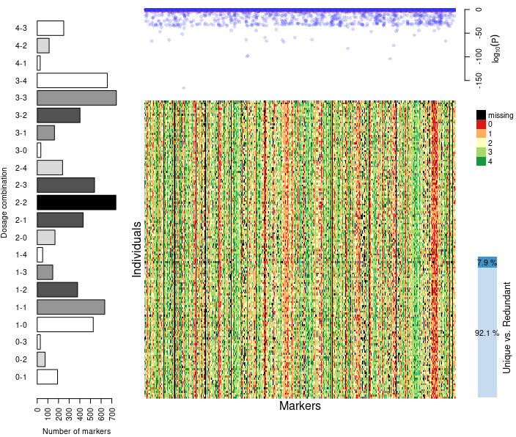
Inspecting data loaded from fitPoly files

Slide 10
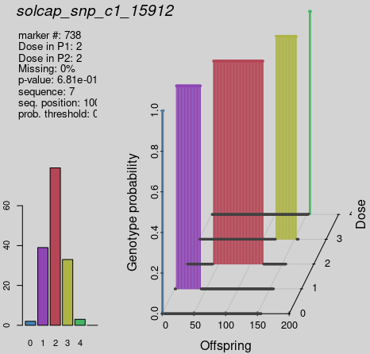
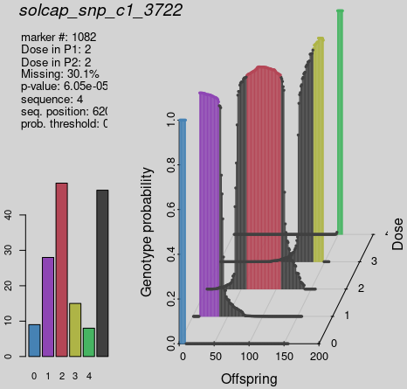
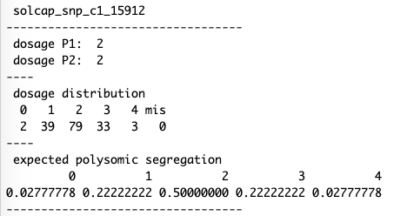
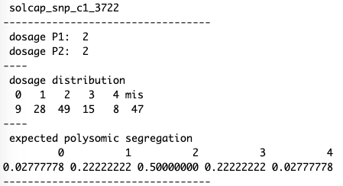
Inspecting specific marker
plot_mrk_info(dat, 738)
print_mrk(dat, 738)
plot_mrk_info(dat, "solcap_snp_c1_3722")
print_mrk(dat, "solcap_snp_c1_3722")

Slide 11
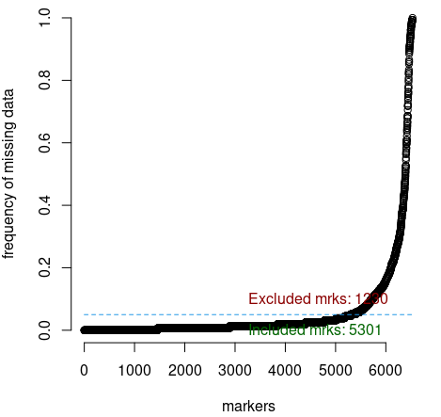
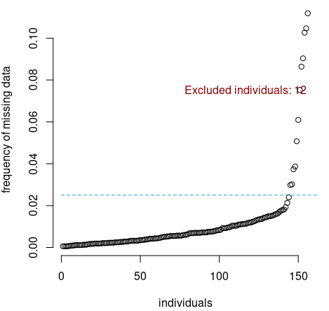
Filtering by missing data
dat <- filter_missing(input.data = dat,
type = "marker",
filter.thres = 0.05)
dat <- filter_missing(input.data = dat,
type = "individual",
filter.thres = 0.025)

Slide 12
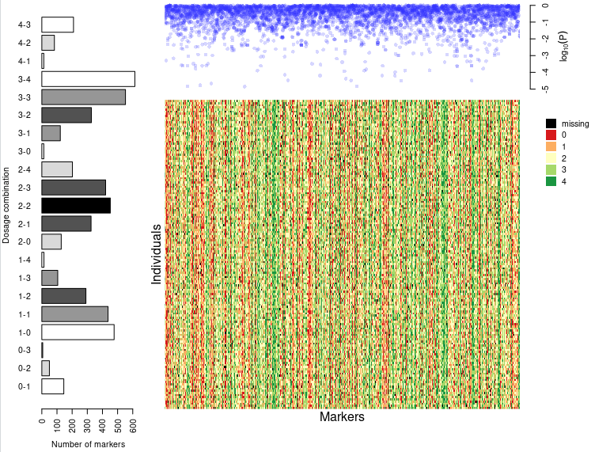
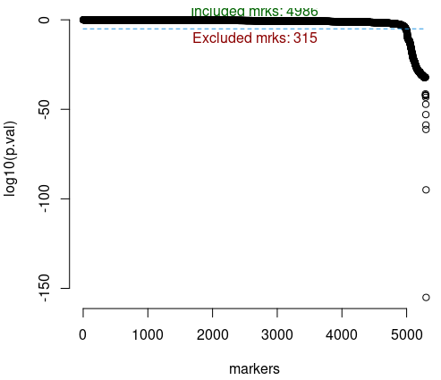
Filtering by segregation distortion
s <- filter_segregation(input.data = dat, chisq.pval.thres = 0.05/dat$n.mrk)
s <- make_seq_mappoly(s)
plot(s)

Slide 13
Making a sequence of markers
mappoly.data
mappoly.group
mappoly.map
mappoly.chitest.seq
mappoly.sequence
mappoly.pcmap
mappoly.geno.ord

Slide 14

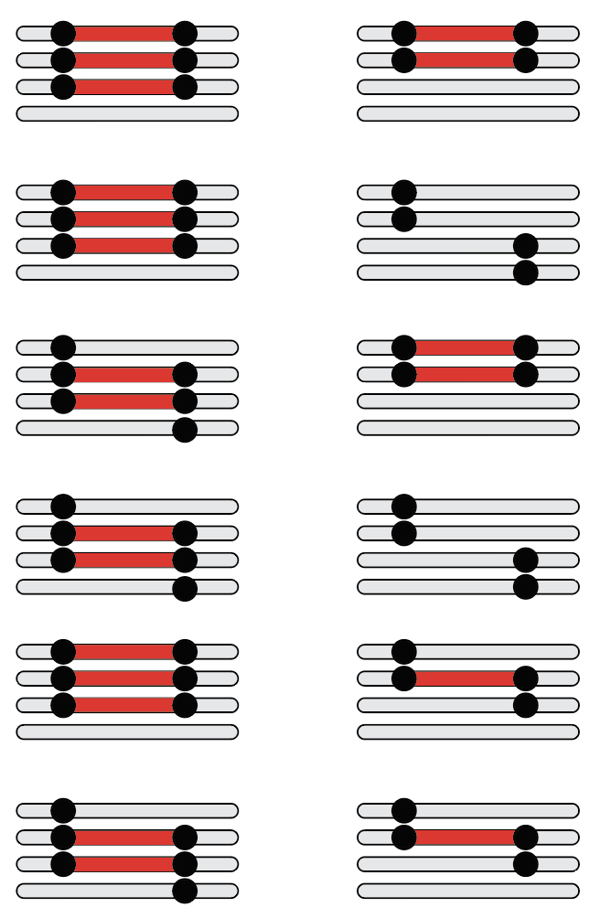
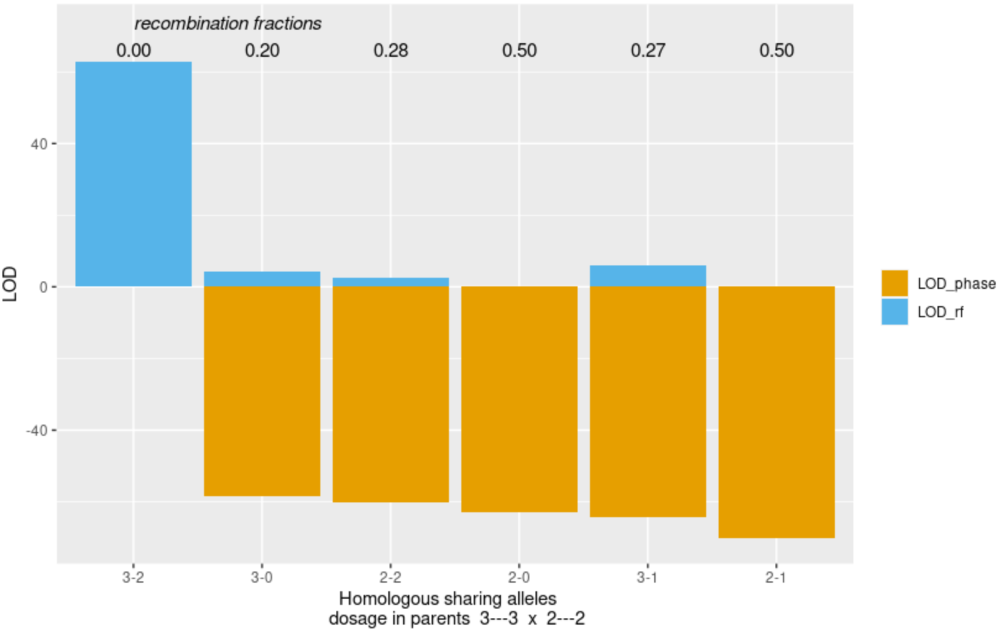
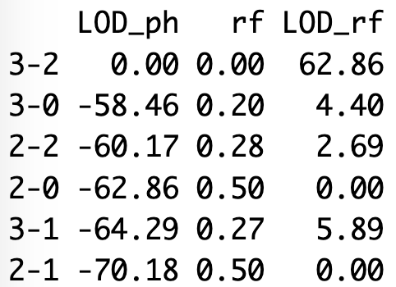
Two-point analysis
## Two-point analysis
nc <- parallel::detectCores() - 1
tpt10 <- est_pairwise_rf(s10, ncpus = nc, est.type = "disc")
tpt10$pairwise[90:92]
round(tpt10$pairwise[[91]], 2)
plot(tpt10, first.mrk = 1, second.mrk = 2074)
Atlantic
B1829-5
1
2074
1
2074

Slide 15
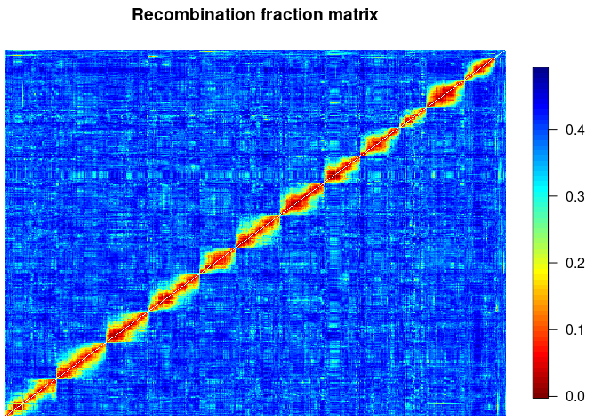
Recombination fraction matrix
m <- rf_list_to_matrix(tpt, ncpus = nc)
gen.ord <- get_genomic_order(s)
s.gen.ord <- make_seq_mappoly(gen.ord)
plot(m, ord = s.gen.ord$seq.mrk.names, fact = 10)

Slide 16
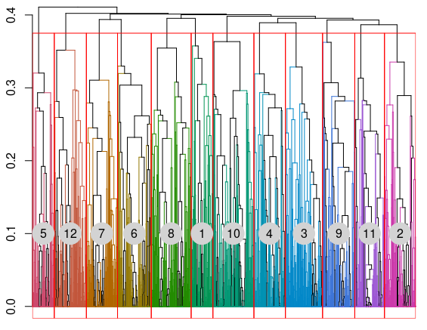
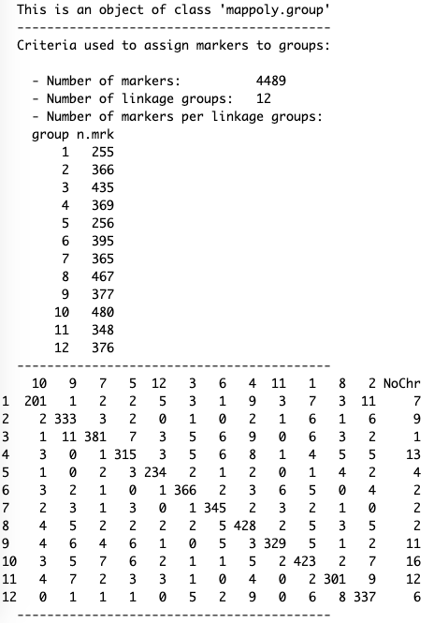
Filtering by pairwise recombination fraction
gr <- group_mappoly(m, expected.groups = 12,
comp.mat = TRUE)
gr

Slide 17
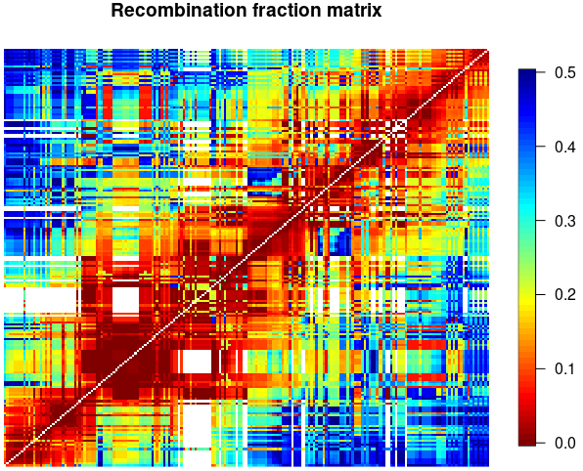
Ordering within a specific linkage group
Genome order
s1 <- make_seq_mappoly(gr, arg = 1,
genomic.info = 1)
tpt1 <- make_pairs_mappoly(tpt, s1)
m1 <- make_mat_mappoly(m, s1)
##Genomic order
g.o1 <- get_genomic_order(s1)
s1.g <- make_seq_mappoly(g.o1)
plot(g.o1)
plot(m1, ord = s1.g$seq.mrk.names,
fact = 3)

Slide 18
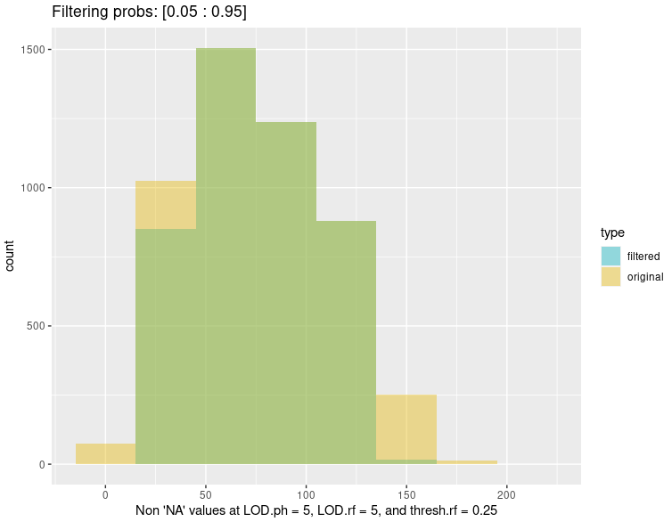
Filtering by pairwise recombination fraction
sf <- rf_snp_filter(input.twopt = tpt,
thresh.LOD.ph = 5,
thresh.LOD.rf = 5,
thresh.rf = 0.25,
probs = c(0.05, 0.95))
mf <- make_mat_mappoly(m, sf)

Slide 19
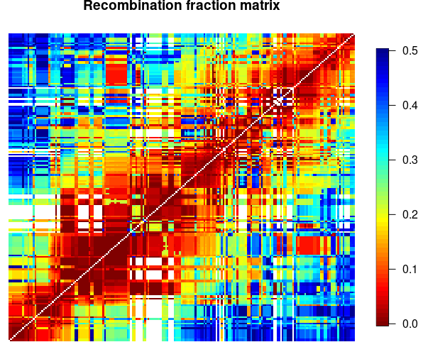
Ordering within a specific linkage group
MDS order
mds.o1 <- mds_mappoly(m1, n = c(201,47))
plot(mds.o1)
s1.mds <- make_seq_mappoly(mds.o1)
plot(m1, ord = s1.mds$seq.mrk.names)

Slide 20
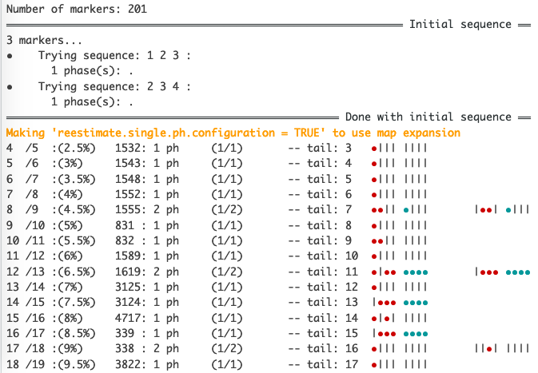
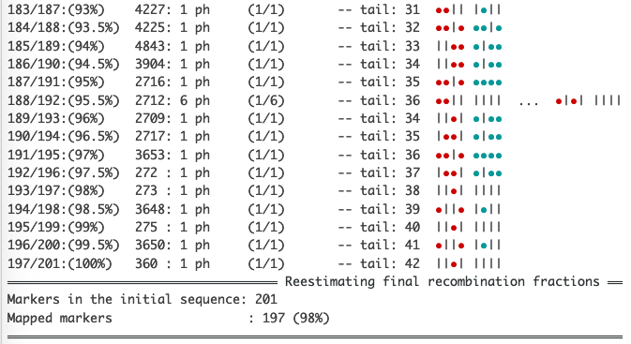
Phasing and HMM estimation of distance
lg1.geno.map<-est_rf_hmm_sequential(input.seq = s1.g,
start.set = 3,
thres.twopt = 10,
thres.hmm = 50,
extend.tail = 30,
twopt = tpt1,
verbose = TRUE,
tol = 10e-2,
tol.final = 10e-4,
phase.number.limit = 20,
sub.map.size.diff.limit = 5,
info.tail = TRUE)

Slide 21
Phasing and HMM estimation of distance
Tetraploid
Hexaploid
Argument | Value
start.set | 3 – 10
thres.twopt | 10
thres.hmm | 10 – 50
extend.tail | 30 – 100
phase.number.limit | 20
sub.map.size.diff.limit | 2 (thousands per LG) … 10 (hundred(s) per LG)
Argument | Value
start.set | 3 – 5
thres.twopt | 10
thres.hmm | 10 – 50
extend.tail | 50 – 200
phase.number.limit | 20
sub.map.size.diff.limit | 2 (thousands per LG) … 10 (hundred(s) per LG)

Slide 22
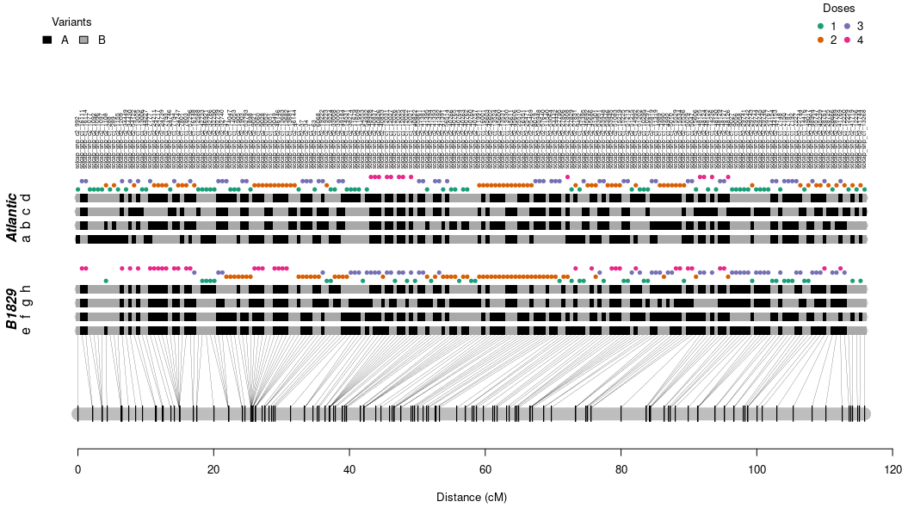
Resulting map
plot(lg1.geno.map, mrk.names = TRUE, cex = 0.5, P = "Atlantic", Q = "B1829")

Slide 23
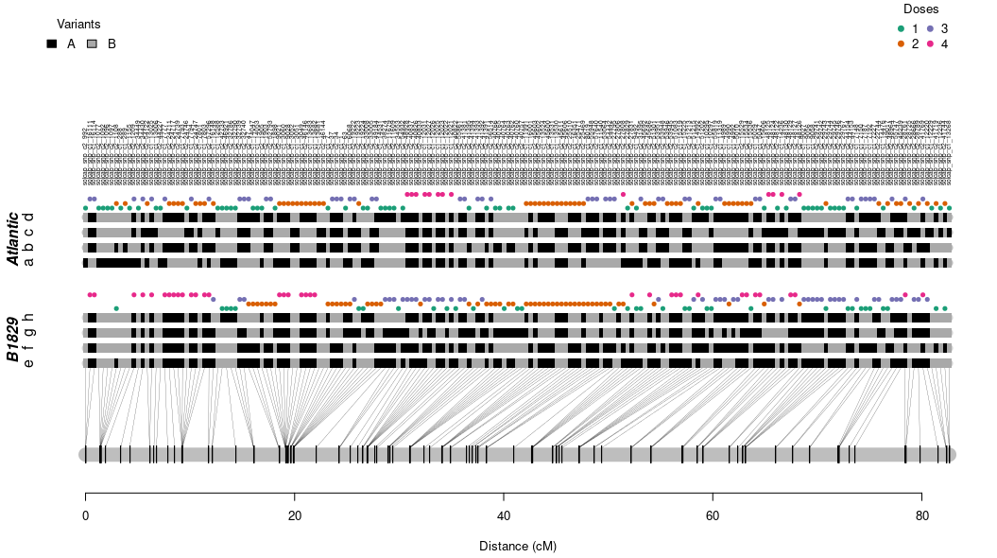
Resulting map – error modeling
lg1.geno.map.err <- est_full_hmm_with_global_error(lg1.geno.map, error = 0.05, tol = 10e-4)
plot(lg1.geno.map.err, mrk.names = TRUE, cex = 0.5, P = "Atlantic", Q = "B1829")

Slide 24
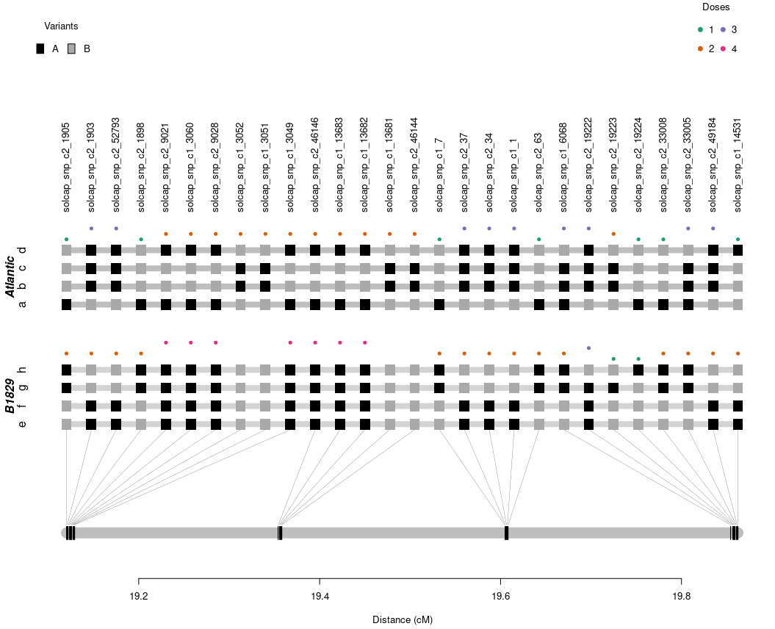
Resulting map: 20-30 cM segment
plot(lg1.geno.map.err,
mrk.names = TRUE,
left.lim = 19,
right.lim = 20,
P = "Atlantic",
Q = "B1829")

Slide 25
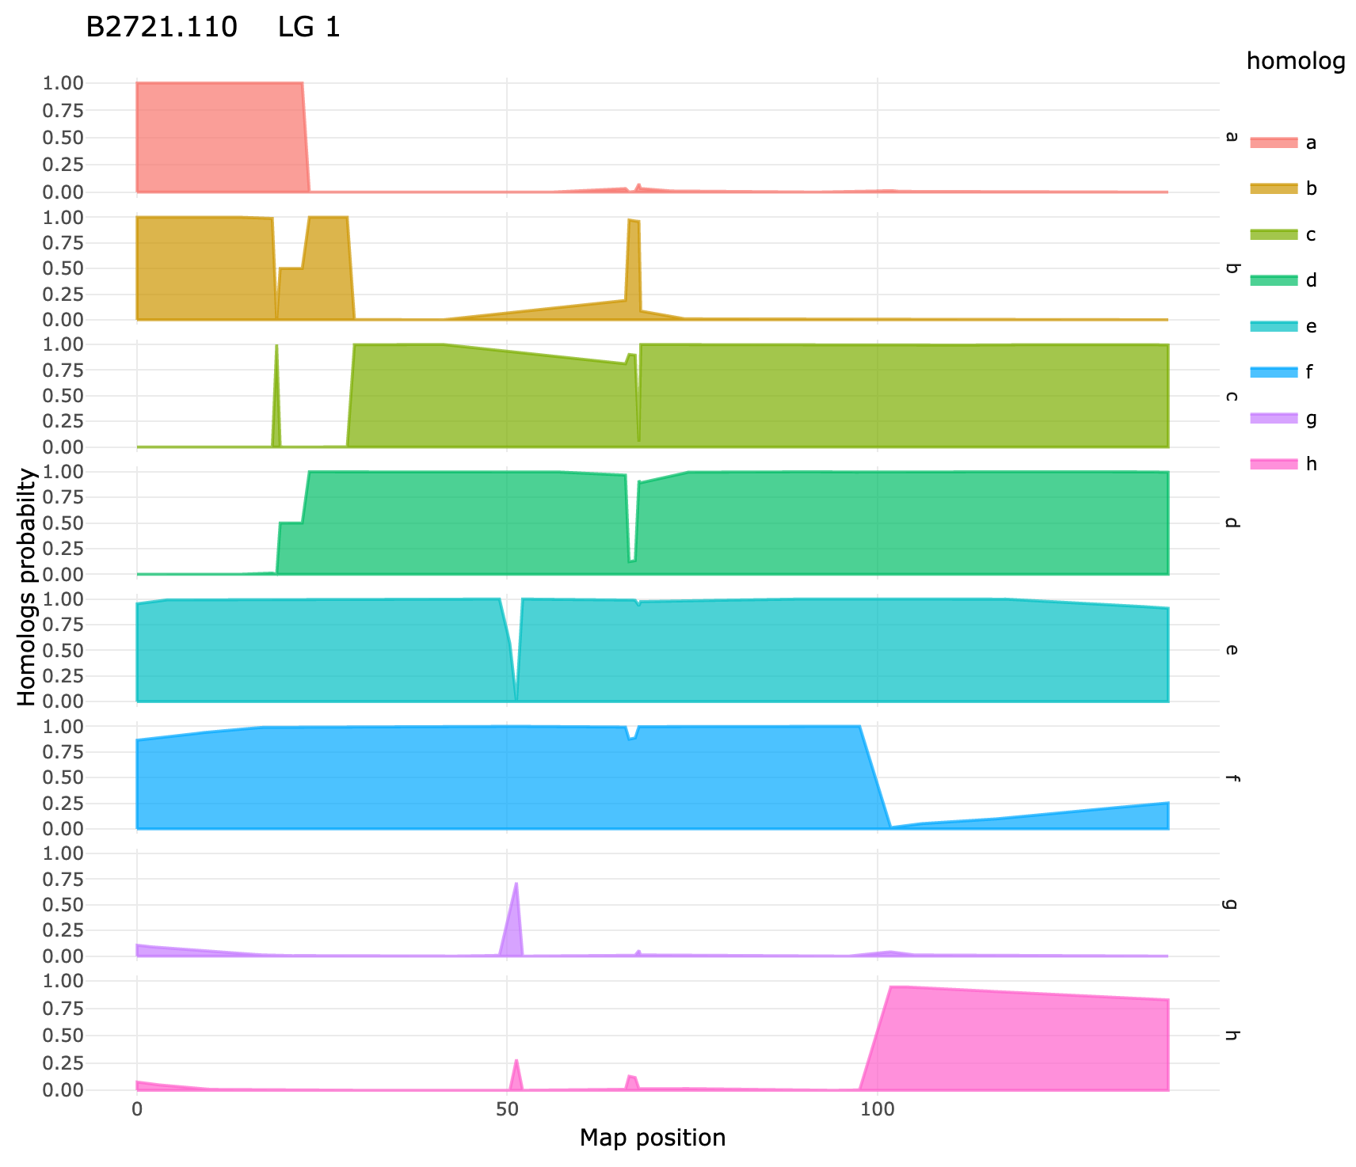
Probabilistic haplotype reconstruction
g.lg10 <- calc_genoprob(lg10.geno.map, step = 1)
h.lg10 <- calc_homoprob(g.lg10)
plot(h.lg10, ind = "B2721.110")

Slide 26
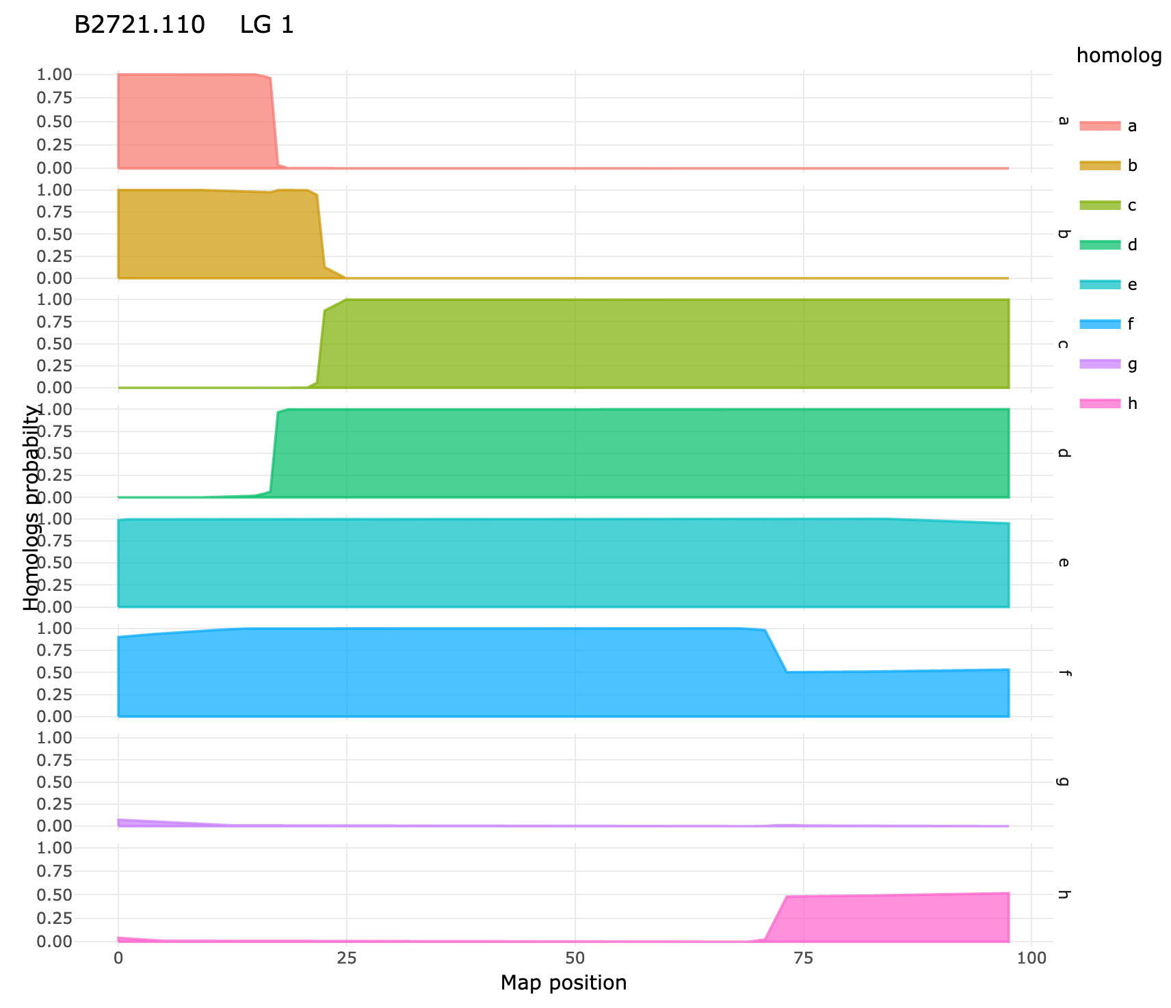
Probabilistic haplotype reconstruction
g.lg10.err <- calc_genoprob_error(lg10.geno.map.err, step = 1, error = 0.05)
h.lg10.err <- calc_homoprob(g.lg10.err)
plot(h.lg10.err, ind = "B2721.110")

Slide 27
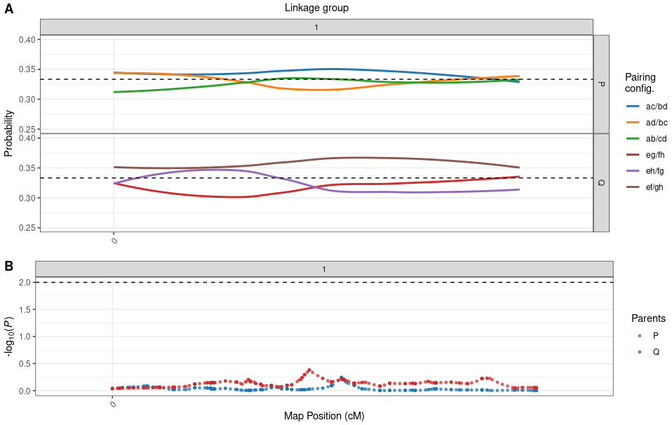
Preferential pairing profiles
p1 <- calc_prefpair_profiles(g1)
plot(p1, min.y.prof = 0.25, max.y.prof = 0.40)

Slide 28
Parallel map construction – genomic order
#### Functions ####
phasing_and_hmm_rf <- function(X){
dir.create("map_output", showWarnings = FALSE)
fl <- paste0("output_map_ch_", X$seq$sequence[1], ".txt")
fl <- file.path("map_output", fl)
sink(fl)
map <- est_rf_hmm_sequential(input.seq = X$seq,
start.set = 3,
thres.twopt = 10,
thres.hmm = 50,
extend.tail = 30,
twopt = X$tpt,
verbose = TRUE,
phase.number.limit = 20,
sub.map.size.diff.limit = 5)
sink()
return(map)
}
error_model <- function(X, error = 0.05, tol = 10e-4){
x <- est_full_hmm_with_global_error(input.map = X,
error = error,
tol = tol,
verbose = FALSE)
return(x)
}
#### Parallel map construction
cl <- parallel::makeCluster(12)
parallel::clusterEvalQ(cl, require(mappoly))
parallel::clusterExport(cl, "dat")
# ~12.5 minutes
MAPs.geno <- parallel::parLapply(cl, LGS, phasing_and_hmm_rf)
# ~2.5 minutes
MAPs.geno.err <- parallel::parLapply(cl, MAPs.geno,
error_model)
# ~22 seconds
genoprob <- parallel::parLapply(cl,
MAPs.geno.err,
calc_genoprob_error,
step = 1,
error = 0.05)
parallel::stopCluster(cl)
#### Map results
map.out <- plot_map_list(MAPs.geno.err, col = "ggstyle")
map.out
plot_genome_vs_map(MAPs.geno.err, same.ch.lg = TRUE)
summary_maps(MAPs.geno.err)
export_map_list(MAPs.geno.err, file = "output_map.csv")
#### Correspondence with genome
z<-as.numeric(colnames(gr$seq.vs.grouped.snp)[1:12])
#### Assembling linkage groups (order based on genome)
LGS<-vector("list", 12)
for(ch in 1:12){
cat("\n ~~~~~~ ch:", ch, "...\n")
lg <- which(z==ch)
s.temp<-make_seq_mappoly(gr, lg, genomic.info = 1)
tpt.temp <- make_pairs_mappoly(tpt, s.temp)
s.temp.filt <- rf_snp_filter(tpt.temp, 5, 5, 0.15, c(0.05, 1))
m.temp <- make_mat_mappoly(m, s.temp.filt)
g.o <- get_genomic_order(s.temp)
s.g <- make_seq_mappoly(g.o)
tpt.temp <- make_pairs_mappoly(tpt, input.seq = s.g)
LGS[[ch]] <- list(seq = s.g, tpt = tpt.temp)
}
#### Preferential pairing
pp <- calc_prefpair_profiles(genoprob)
print(pp)
head(pp$prefpair.psi)
plot(pp, P = "Atlantic", Q = "B1829")
#### Haplotype probabilities
hp <- calc_homoprob(genoprob)
print(hp)
plot(hp, ind = 2, lg = 1)
plot(hp, ind = 2, lg = 1:12, use.plotly = FALSE)

Slide 29
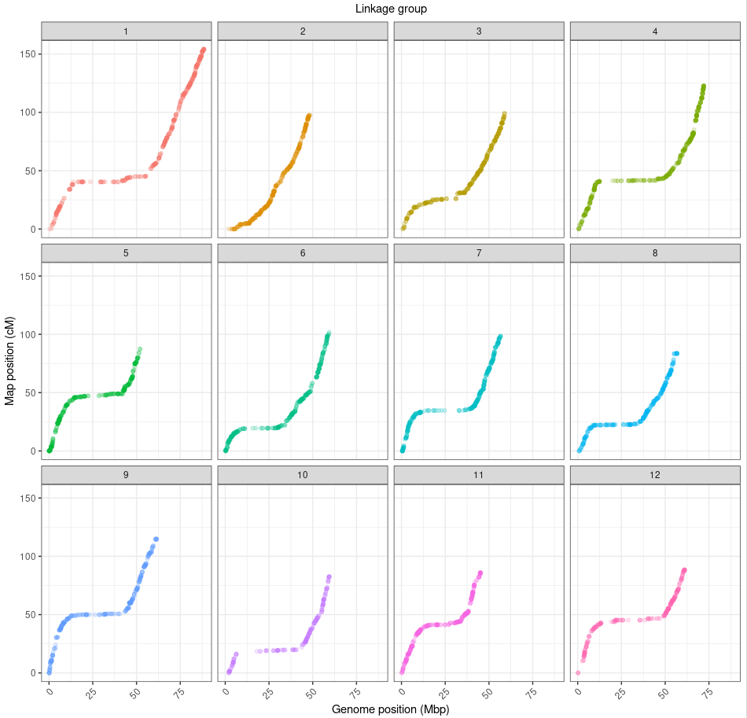
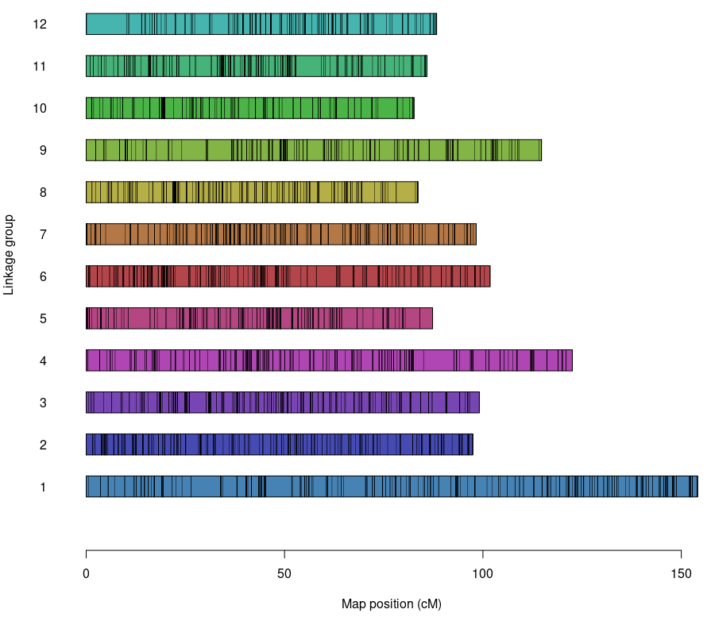
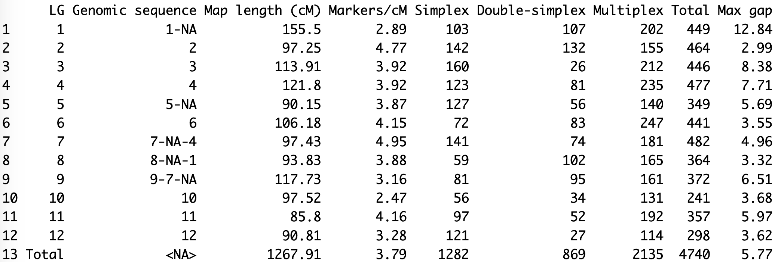
Results

Slide 30
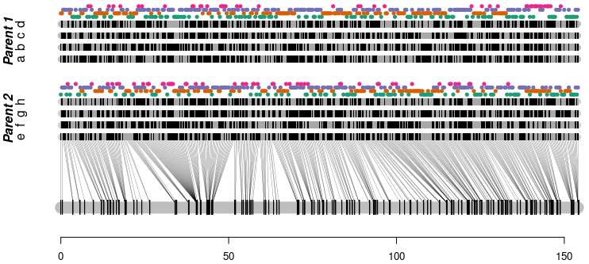
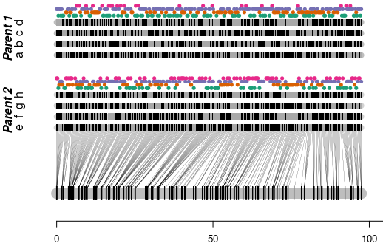
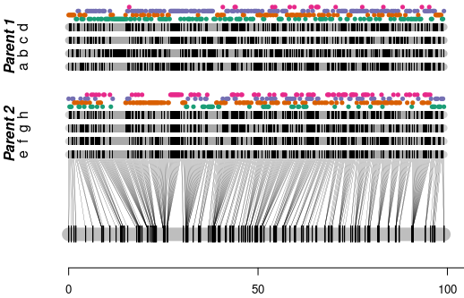
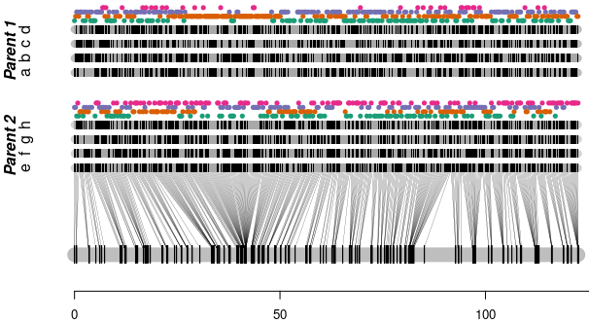
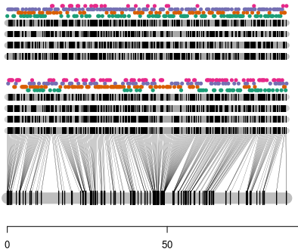
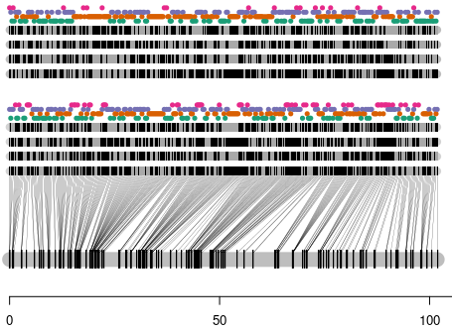
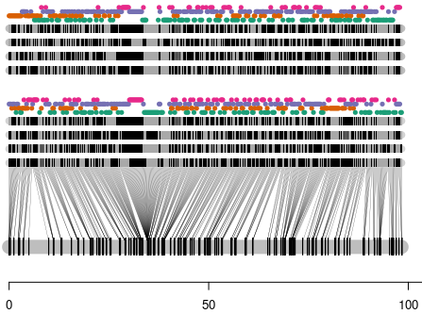
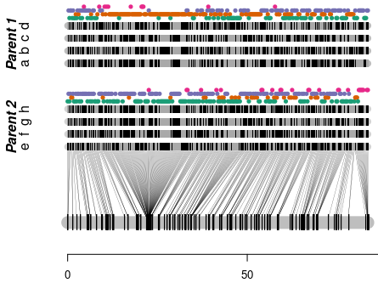
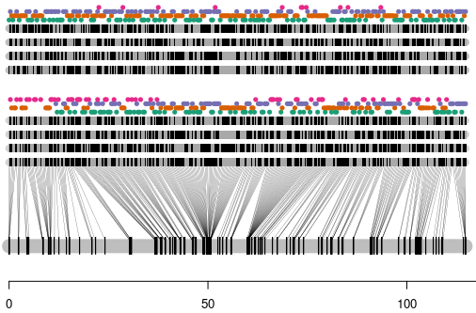
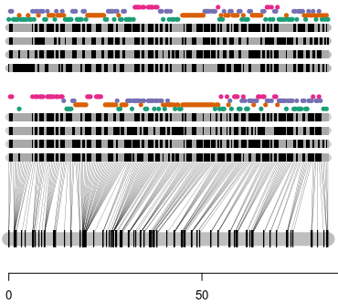
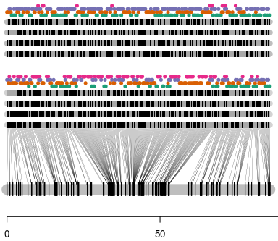
Results – phased map

Slide 31
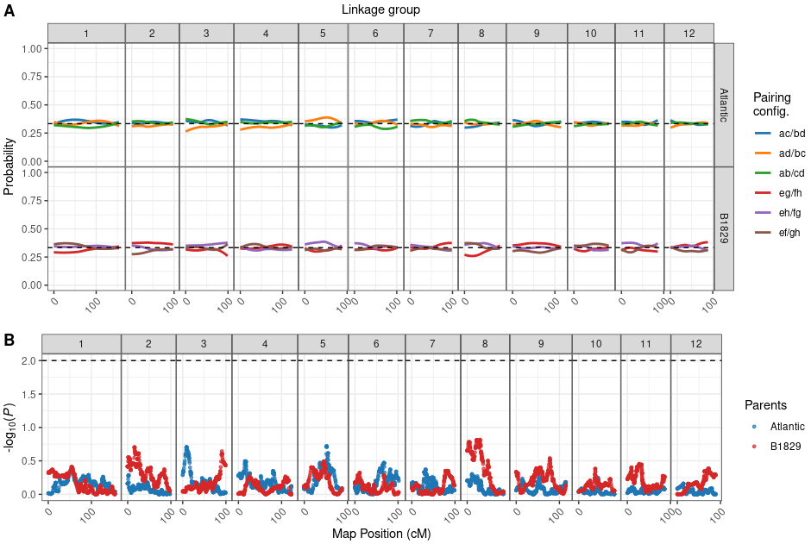
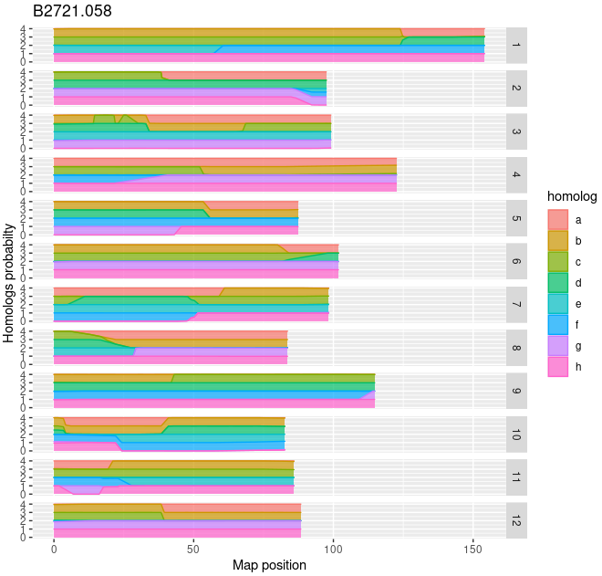
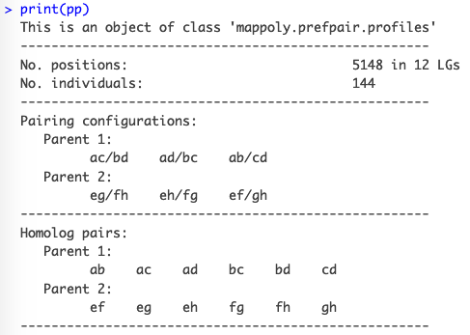
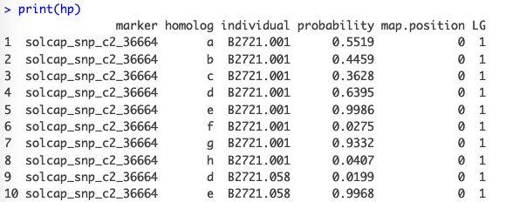
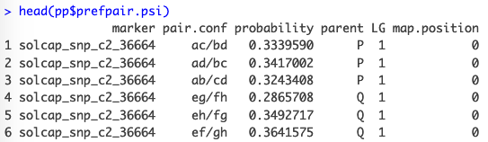
Results

Slide 32
On-line resources
MAPpoly web page
GitHub page for the topics I presented in this workshop
Tetraploid: B2721 potato biparental population (Atlantic x B1829-5)
Hexaploid: BT sweetpotato population (Beauregard x Tanzania)
Detailed analytic procedures for Pereira et al. (2020)

Slide 33
APPENDIX Hexaploid map – Results

Slide 34
Hexaploid map – Results
Script for hexaploid
https://github.com/mmollina/SCRI/tree/main/MAPpoly/hexa
Complete map
Unraveling the Hexaploid Sweetpotato Inheritance Using Ultra-Dense Multilocus Mapping (Mollinari et al., 2020).
Shiny applications
Map: https://gt4sp-genetic-map.shinyapps.io/bt_map/
Haplotypes: https://gt4sp-genetic-map.shinyapps.io/offspring_haplotype_BT_population/

Slide 35
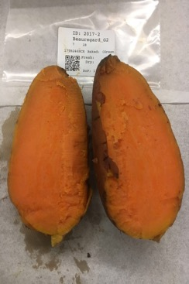
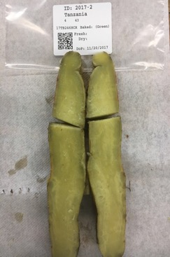

Biparental Population - BT
Beauregard x Tanzania
315 individuals
GBS – GBSpoly protocol (Bode Olukolu – U Tennessee)
Two reference genomes I. trifida and I. triloba (Zhangjun Fei’s group – BTI Cornell). In the available dataset we used I. trifida.
In this example we used three chromosomes: ch3, ch9 and ch12
X
Beauregard
Tanzania

Slide 36


Biparental Population - BT

Slide 37



Results for hexaploid sweetpotato BT population

Slide 38



Recombination fraction matrix and grouping

Slide 39

Ordered recombination fraction matrix

Slide 40






Map results

Slide 41

Homologs probability

Slide 42

Preferential pairing profiles

